Slide 1
OS – System Calls
CS 0449
Jarrett Billingsley

Slide 2
Class announcements
:B

Slide 3
The OS

Slide 4
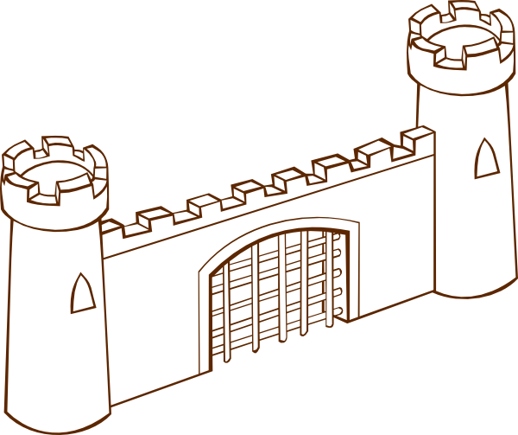
The responsibilities of the OS
resource control.
  it's the gatekeeper to all the computer's resources
process control.
  it makes everyone play nice
  it can kill broken/evil processes
hardware abstraction.
  since processes must ask OS to access resources on their behalf…
  the OS can make processes believe things that aren't real
CPU
RAM
Network
off with their head!
OS
Memory
Memory
there's 128GB of RAM!!!
also the sky is green!!!!
Code
Memory
Code
Code
this isn't really painting a flattering picture of the OS, is it
Notes:
[diagram: a castle labeled OS. inside the castle are the CPU, RAM, and Network (among other things). the processes are outside the castle and are the lowly serfs]

Slide 5
Walled cities
the OS kernel is a program – a process – that manages all the rest
it can access any resource and control any other process
  how do we keep that power from falling into the wrong hands?
  and how do we do it on a computer with only a single CPU??
    how do we even run multiple processes on a single CPU
Process 1
Process 2
Memory
Memory
Code
Code
OS Kernel
Notes:
[diagram: two processes running on top of the kernel.]

Slide 6
Building the castle
CPUs can run in (at least) two modes:
  user mode, for running "untrusted" processes
  kernel mode, for running the kernel (duh)
user mode is very restricted:
  many instructions are illegal
  most of the memory is off-limits
  all addresses are virtual
  hardware can't be accessed
so… how do we switch modes?
User
Mode
Process 1
Process 2
Memory
Memory
Code
Code
Kernel
Mode
OS Kernel
Notes:
- there are typically other modes, such as hypervisor mode (for running virtual machines) and "system management mode" (for doing even more low-level stuff)
[diagram: last slide, but the processes are indicated as running in user mode, and the kernel in… kernel mode.]

Slide 7
System Calls

Slide 8
System calls
a system call is a special kind of
function call that user-mode
processes use to ask the OS to
do something for them.
  if the OS is the castle wall…
  then syscalls are a gate
system calls are a CPU feature
  since it must switch modes
…We deem it acceptable.
OS
syscall
please Sire, I am but a Mere Process, hungry for some RAM…
Memory
Code
Notes:
[diagram: the castle again, but the gate in the castle wall is labeled syscall. the process asks for access, and King OS says it's okay.]

Slide 9
System call CPU mechanisms
you learned how to do them in MIPS
  it's…. syscall
in x86-64, it’s…… also syscall
on both, you put the syscall number in a certain register
  this identifies which operation the process wants to perform
  it’s v0 on MIPS and rax on x86-64
the arguments get passed almost as usual
  on x86-64 versions of Linux, argument 4 goes in r10 instead of rcx because apparently rcx is used as the return address register by the syscall instruction… aaa then why did they specify rcx
then you perform the syscall instruction
and then…
MIPS | x86-64
syscall | syscall
Notes:
there’s a great list of all 335 syscalls available in Linux 4.7 here: https://web.archive.org/web/20230904231952/https://blog.rchapman.org/posts/Linux_System_Call_Table_for_x86_64/

Slide 10
Opening the portal
switching modes causes a few things to happen
User Space
mov rdi, 0
mov rax, 60
syscall
the CPU switches memory spaces:
the kernel has its own memory
Kernel Space
swapgs
mov [sp2], rsp
mov rax, cr3
execution jumps to the system
call handler in the kernel
Stack
3
2
1
45
Stack
0
78
0
the kernel also has its own stack
and of course, the CPU is now
in kernel mode
Notes:
[diagram: just like a user-mode process, the kernel has its own stack, its own code, etc.]

Slide 11

The upside-down
kernel code is pretty similar to user code
  there are some restrictions, like no libc
  but you can do special things
  like accessing other processes’
  memory spaces
so if the user e.g. passes a pointer to an array of characters to print out…
  the kernel can see it no problem
User
Space
Kernel
Space
Stack
3
2
1
Stack
Notes:
[diagram: the kernel can access user-mode processes' memory.]

Slide 12

Switching tracks
when the kernel is done handling a syscall…
  it could return to the user process
  or it could switch to another user process!
this is how one CPU can run many processes
at any given moment, it's only running one
  but over time, they all get some attention
the OS is like a juggler
Notes:
- we'll come back to this in multiprocessing.
[image: a man juggling]

Slide 13
Context Switches

Slide 14
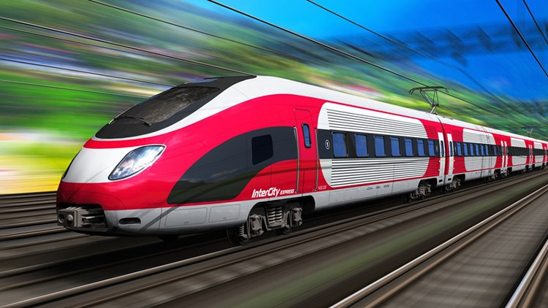
Barreling down the track
a context switch is when the CPU changes modes.
but the CPU is like a train:
  high speed in a straight line
  but slow to change directions.
so we have this annoying problem:
  we need the OS to do anything
  but system calls require a context
  switch, which is slow.
Notes:
[image: a high-speed train]

Slide 15

Layer cake
user programs usually look like this:
the layers in the middle do a good bit of work trying to make as few system calls as possible.
as an example, let's look at a common one: buffered I/O
User
Space
Program code
Language Runtime (libc, msvcrt, JRE)
Public OS API
(POSIX, Win32)
Kernel
Space
OS Kernel
Syscall Handler
Notes:
[diagram: in user space, you have three layers: your program code talks to your language runtime (like the C standard library, or the Java class library); that then talks to the public OS API (like POSIX or Win32). the public OS API then crosses the boundary between user and kernel mode to access the syscall handler.]

Slide 16
Don't do it all at once
there is a fixed overhead for context switches
so if we can do more work per switch, we can reduce their impact.
let's say we're writing to a file.
when the buffer is full or flushed, then a syscall is made
each fwrite() copies the data into a buffer: an area of memory managed by stdio
buffer
this way to OS
hello
goodbye
whatever
fwrite(f, "hello\n")
fwrite(f, "goodbye\n")
fwrite(f, "whatever\n")
fflush(f)
and the buffer is empty again.
Notes:
[diagram: each fwrite just puts the data into a buffer inside user space. when the data is fflushed, we just do 1 syscall to copy it all to the OS.]

Slide 17
An example with fgets()
if the user types in more text than there's room for in your array…
the rest of the line is still in the input buffer, and the next call to fgets will get that buffered data
  it will not wait for you to type more!
your input array
stdio's buffer for stdin
a | b | c | \0
a | b | c | d | e | f | g | \n
still in the buffer!
next fgets will get this.
fgets(input, 4, stdin)
Notes:
[diagram: you made a 4-item char array. stdio's stdin buffer is much longer, and has an 8-character string in it. when you fgets with a length of 4, it only copies the first 3 characters out of stdio's buffer into your array (and then zero-terminates); the other 5 characters are still in stdio's buffer.]

Slide 18
The POSIX API

Slide 19
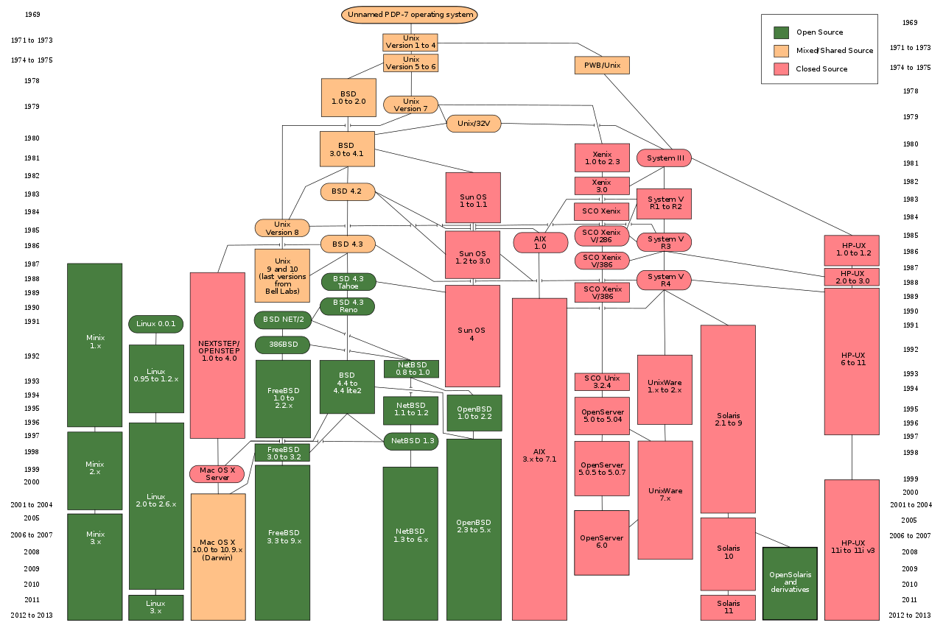
The POSIX API
POSIX stands for Portable
Operating System Interface.
(the X just looks cool.)
POSIX was defined as a
universal API for all the
flavors of UNIX,
which Linux
(mostly)
implements
as well.
this is why it
was needed.
Notes:
[diagram: the enormous, messy family tree of the dozens of variants and descendants of the original UNIX from 1969.]

Slide 20
The POSIX API
Linux and macOS (mostly) implement POSIX
  but historically not Windows, cause Windows
    but I guess that's changing-ish.
it's based on this idea: what if everything were a file
  Hard drives? Files.
  Displays? Files.
  Keyboards? Files.
  Processes? Files.
  Files?..............................
    Files.

Slide 21
The big unifying concept
everything on the system is represented in this big tree
the root of this tree is is /, which is called… the root directory
the internal nodes are directories, and the leaves are files
directory names always end in a /
we can also have symbolic links
  they're basically pointers.
  when we access /bin/sh on thoth it’s really accessing /bin/dash.
/
dev/
bin/
usr/
sh
dash
tar
Notes:
[diagram: a tree. the root directory is forward slash. inside it are folders. inside folders are other folders and files. one of the files is a symbolic link, which is really just a "pointer to another file in the filesystem."]

Slide 22
Accessing the “file” system
there are four main system calls, and they look familiar-ish…
  int open(const char* filename, int flags);
  int read(int fd, void* buffer, size_t size);
  int write(int fd, const void* buffer, size_t size);
  int close(int fd);
these are the real deal – when you call these functions, you are talking directly to the OS!
there is no FILE* here. that is a <stdio.h> abstraction.
open() returns a file descriptor instead.
  this is just an integer which uniquely identifies the open file.

Slide 23


The standard input/output/error files
every process on a POSIX system is given
these three files when it starts.
Java names these System.in, System.out,
and System.err.
notice that their file descriptors are 0, 1, 2.
  starting at 0 and going in order… hmm… array??
Name | Descriptor
stdin | 0
stdout | 1
stderr | 2
Memory
stdout
stdin
stderr
Code
this is the default arrangement, but it can be changed easily with...
Notes:
- if I opened another file, what do you think its descriptor would be?
[diagram: by default, the keyboard is hooked to stdin; stdout and stderr are both hooked to the console screen.]

Slide 24
Redirection
redirection lets you connect the standard files to things other than the keyboard and console. (these examples are for bash)
$ ls > output.txt
$ ./lab1 < test.txt
now anything the program prints ends up in the file output.txt instead.
now every time the program asks for a line of text, it reads it from test.txt instead of the user.
Memory
stderr
Memory
you can redirect both at the same time, and redirect stderr as well (see slide notes).
stdin
Code
stdout
100
earth
mars
pluto
exit
Code
1_hello_world
1_hello_world.c
noodle.bmp
stdout.txt
test.txt
Notes:
redirecting both is as simple as “./program < input_file > output_file”.
redirecting stderr looks like this: “./program 2> errors.txt”. The 2 is because stderr is file number 2. (See table on previous slide.)
it’s also possible to redirect stderr to “the same place as stdout” by doing “./program 2>&1”, so both stdout and stderr will output to the same place – either both to the console, or both to a single file.

Slide 25

World 7
a pipe is a form of redirection which connects the output of one process directly to the input of another.
let’s try ps aux | less
here’s what’s happening:
pipe
stdout
stdin
ps aux
less
wordswordswordswordswordswordswordswordswordswords
Notes:
this is how the autograder works – I run your program “hooked up” to the autograder. I write things to your program’s stdin, wait, and then read things from its stdout. (most of the time.)

Slide 26
Watching it go
We can see all the system calls a program makes as it runs using the strace command.
Let’s strace a simple “hello world” program.
  execve is the call the actually runs the program. (sorta.)
  brk is used to see where the heap begins. (hey, that's familiar!)
  access checks if you can… access a file 🙃
  openat seems to be a newer version of open that plays more nicely with multi-threading and avoids race conditions.
  newfstatat gets information about an open file.
  mmap (memory map) manipulates the virtual memory map.
    mprotect lets you change the access rights on memory areas.
    munmap gives the mapped memory pages back to the OS.
there’s more stuff in there but you get the idea!

